Slide 1
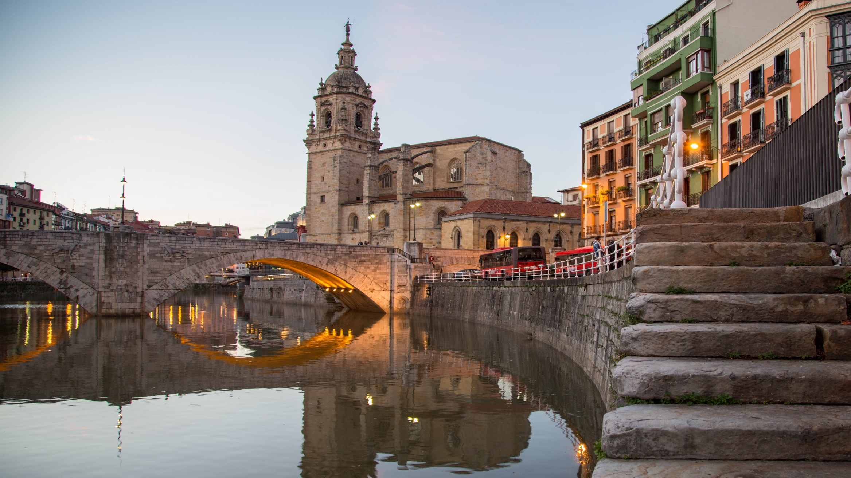


EUSKALDUNA
CONFERENCE CENTER
OCTOBER 1-3,
2018
Social Economy and Cities
Values and
competitiveness
for an inclusive and sustainable local
development
www.gsef2018.org

